Slide 1

Mini Project-II (AI101B) Even Semester Session 2024-25
CREDIT CARD FRAUD DETECTION
Devansh Batta 242610116100058
Anurag Singh Kushwaha 242610116100039
Chitransha Bhatt 24261011610054
Bhavna Rajput 242610116100049
Project Supervisor:
Apoorv Jain
Assistant Professor

Slide 2
Content
Introduction (1 slide)
Literature Review (1 slides)
Objective of the Project (1 slide)
Technology
Hardware Requirements (Development Environment, Server requirement (if required), Client requirement (if required).
Software Requirements (Language and Platforms like Frameworks, VS code, Android Studio and Jupyter notebook etc. )
Modules (2 slides)
Workflow (1 slide)
Reports (For Example: Project : Student Monitoring System, so reports like: Student Marks, Subjects, companies visit, and student appears in placement etc.)
References (1 slide)
Notes:
Font Styles: Times New Roman + Font Size: 25

Slide 3
Introduction
Credit Card Fraud Detection involves identifying unauthorized or fraudulent transactions using machine learning.
Fraud detection is crucial due to the massive number of daily financial transactions.
The key challenge is the extreme class imbalance between fraudulent and non-fraudulent cases.
In this project, we used Logistic Regression and Random Forest models to identify fraudulent activities with proper evaluation and visualization.
Notes:
Font Styles: Times New Roman + Font Size: 25

Slide 4
Literature Review
Fraud detection research has evolved from rule-based systems to machine learning-based systems.
Various classification models like Logistic Regression, Decision Trees, and Random Forest have shown promising results.
Handling class imbalance (e.g., upsampling, SMOTE) is critical.
Evaluation metrics such as AUC, F1-score, and precision-recall are prioritized over accuracy.
Real-time fraud detection systems aim to balance detection rate and performance speed.
Notes:
Font Styles: Times New Roman + Font Size: 25

Slide 5
Objective of the Project
To detect fraudulent credit card transactions using machine learning.
To handle class imbalance using upsampling.
To compare Logistic Regression and Random Forest models.
To evaluate performance using AUC, F1-score, precision, and recall.
To visualize confusion matrices and ROC curves.
To optimize model performance in a time-efficient manner.
Notes:
Font Styles: Times New Roman + Font Size: 25

Slide 6
Technology (Hardware & Software Req.)
Hardware Requirements:
Processor: Intel Core i3 or higher
RAM: 4GB or more
Storage: 10GB free disk space
Software Requirements:
Language: Python
IDEs: Jupyter Notebook, VS Code
Libraries: pandas, NumPy, scikit-learn, seaborn, matplotlib
Tools: Anaconda, Google Colab (optional)
Notes:
Font Styles: Times New Roman + Font Size: 25

Slide 7
Modules
Data Preprocessing
Load dataset safely
Explore data with info(), head(), and class distribution
Plot class balance (fraud vs non-fraud)
Feature Engineering & Scaling
Splieatures and labels
Apply StandardScaler for Normalization
Data Splitting & Balancing
Train-test split with stratification
Upsample minority class to 30% of the majority class
Notes:
Font Styles: Times New Roman + Font Size: 25

Slide 8
Modules (Contd.)
Modeling
Logistic Regression using liblinear solver
Random Forest (n_estimators=50, max_depth=12, max_features='sqrt’)
Evaluation & Visualization
Confusion matrix
Classification report
ROC curve and AUC
Final metric comparison table (precision, recall, F1-score, AUC)
Notes:
Font Styles: Times New Roman + Font Size: 25

Slide 9
Workflow/Gantt Chart
Load and explore the dataset
Preprocess and scale the data
Handle class imbalance via upsampling
Train Logistic Regression and Random Forest models
Evaluate both models
Visualize confusion matrices and ROC curves
Compare metrics and draw conclusions
Notes:
Font Styles: Times New Roman + Font Size: 25

Slide 10
Reports
Dataset class distribution (before and after upsampling)
Confusion matrices for both models
ROC curves and AUC scores
Model training time
Final comparison table of metrics
Insights from trade-offs between precision and recall
Notes:
Font Styles: Times New Roman + Font Size: 25

Slide 11
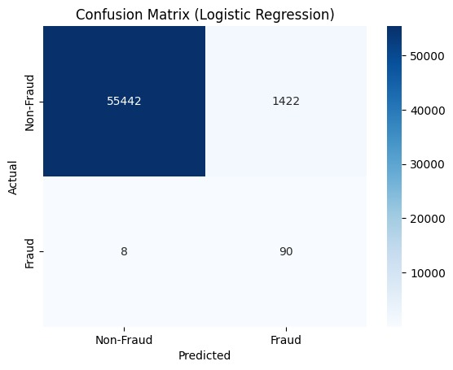
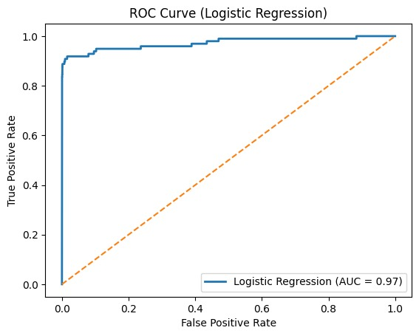

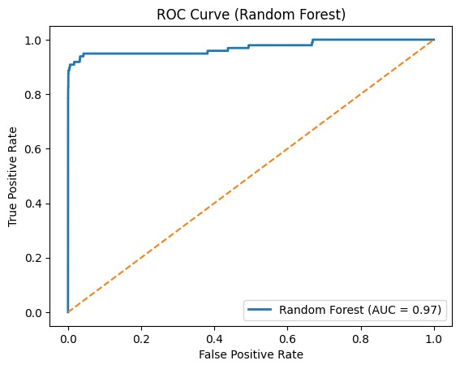

Slide 12
References
Scikit-learn documentation: https://scikit-learn.org/
Python Data Science Handbook by Jake VanderPlas
Kaggle: Credit Card Fraud Detection Dataset
Towards Data Science articles on fraud detection techniques
Machine Learning Mastery by Jason Brownlee
Notes:
Font Styles: Times New Roman + Font Size: 25

Slide 13
Thank You

